Slide 1
Protein Synthesis
How genes work

Slide 2

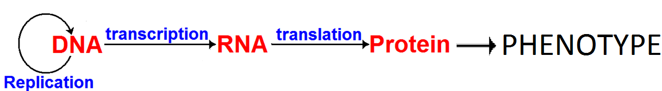
The Central Dogma of Molecular Biology
Note: Some “retroviruses” (e.g. HIV) use RNA not DNA to store their genetic code. They use reverse transcriptase enzyme to convert their code to DNA when attacking cells

Slide 3

The Genetic Code
There are 20 amino acids and only 4 nucleotides on the DNA and RNA.
DNA uses a triplet of nucleotide bases to make one 3-letter mRNA codon to code for one amino acid.
There are only 16 combinations of 2 bases so 2 bases would not be enough
There are 64 possible combinations of 3 bases – 44 more than are needed.
Most a.a’s are coded for by more than 1 codon. This is called ‘degeneracy’.
Degeneracy is useful as if a mutation changes 1 base it may still code for the same amino acid.

Slide 4
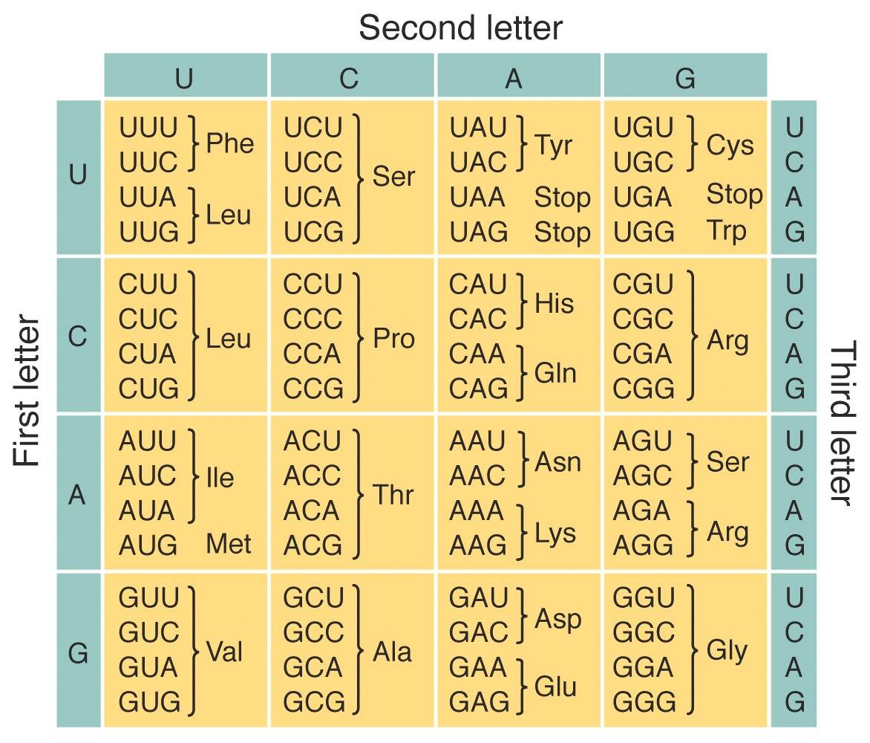
The Genetic Code Dictionary

Slide 5
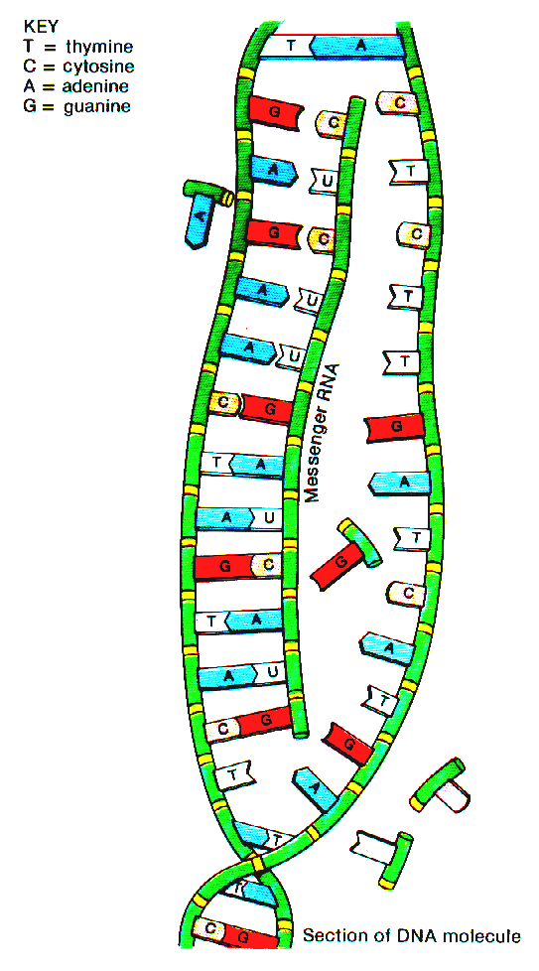
3 kinds of RNA
Messenger RNA (mRNA).
Carries code from DNA in the nucleus out to the ribosomes
Each group of 3 bases is a codon that codes for one amino acid.

Slide 6
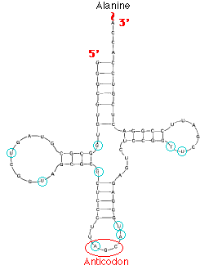
tRNA – transfer RNA
tRNA molecules have:
a ‘Clover-leaf’ shape
a 3-base anticodon on one end. This is complementary to a mRNA codon.
an amino acid attachment site on the other end.

Slide 7
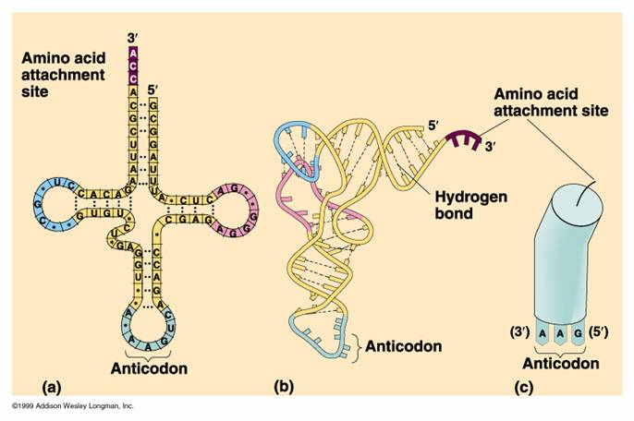
Some tRNA models

Slide 8
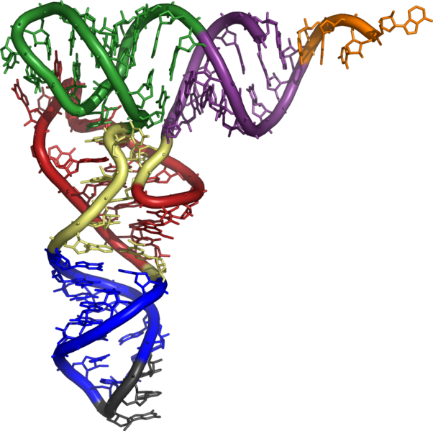
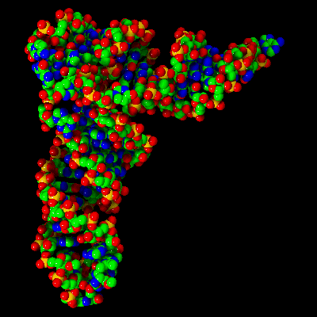
Here are two 3-d model tRNA molecules

Slide 9
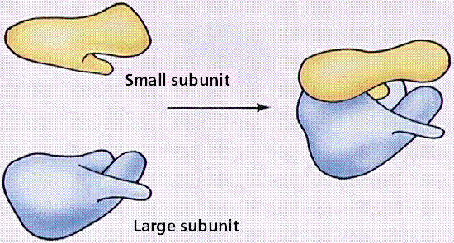
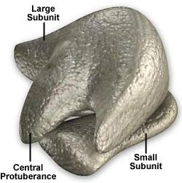
rRNA – Ribosomal RNA
Makes up part of ribosomes – the site of protein synthesis.
Here are two models of rRNA

Slide 10
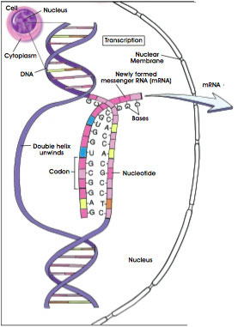
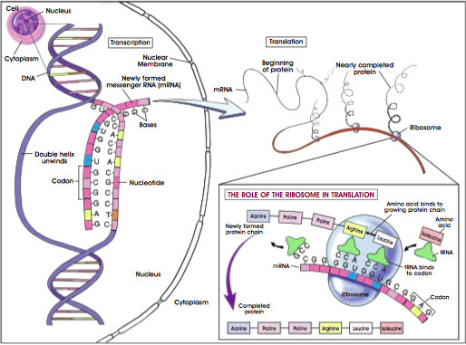
Protein synthesis – an overview

Slide 11
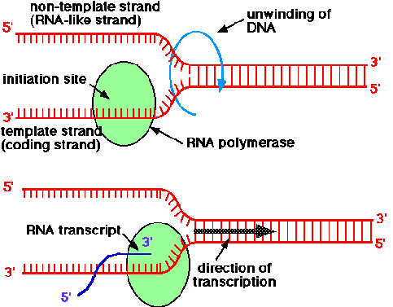
Transcription
In a gene on a DNA molecule, one strand is the coding strand (or sense strand). It is referred to as the RNA-like strand as it has the same base sequence as the RNA transcript product.
The other is the template strand (or antisense strand, or anticoding strand).

Slide 12
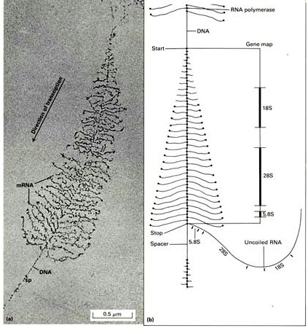
Transcription in bacteria
This shows transcription of several RNA molecules from one gene on a bacterial chromosome. Several polymerase enzymes are working their way down the DNA.

Slide 13
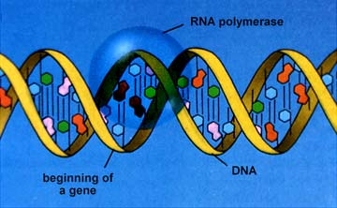
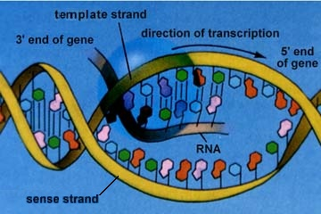
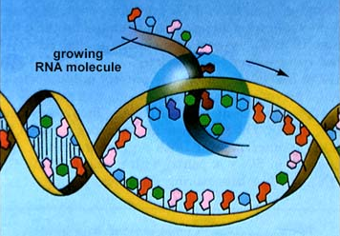
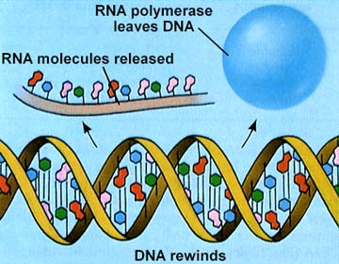
Transcription
RNA polymerase binds to a ‘promotor’ site near the beginning of the gene.
The template strand is used to make a complementary strand of mRNA
Polymerase continues along until it reaches the ‘termination site’
It then detaches.
The mRNA produced moves out into the cytoplasm and DNA rewinds.

Slide 14
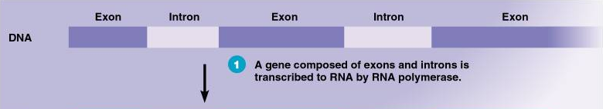
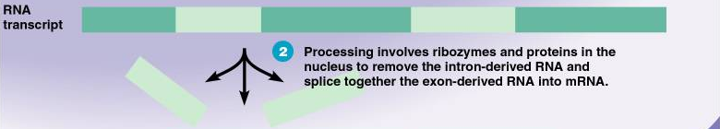
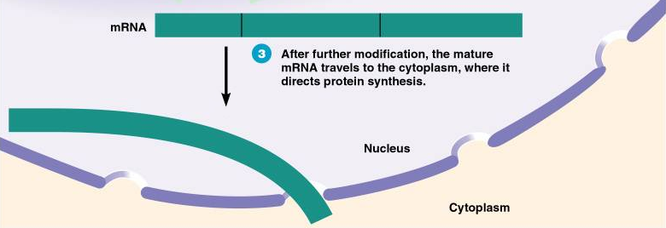
Editing

Slide 15
Translation
In the cytoplasm, the mRNA passes through a slot in a ribosome (or ribosomes move along the RNA)
The anticodons of tRNA molecules temporarily bind to mRNA as it passes by the active site on the ribosome and the amino acids carried by the tRNAs are joined to form a polypeptide.

Slide 16
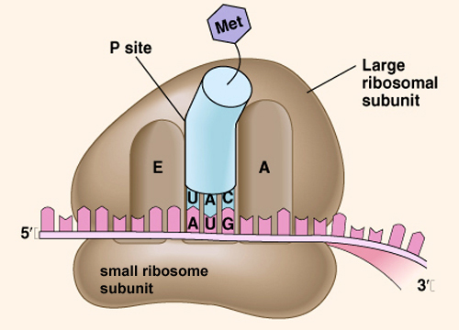
This model shows the ‘active site with mRNA and a tRNA present

Slide 17
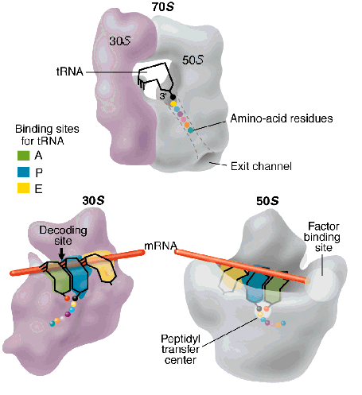
A 3-d model showing a growing amino acid chain

Slide 18
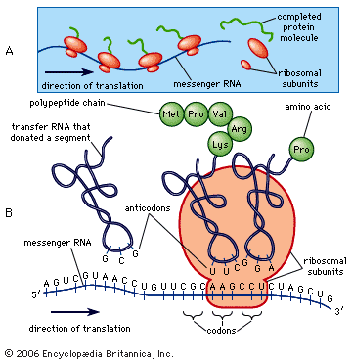

Slide 19
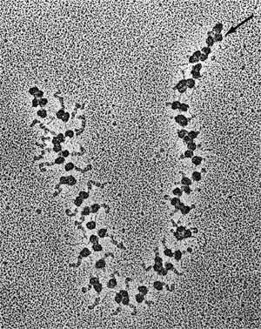
Translation in reality
Several ribosomes may translate a single mRNA molecule at the same time. The beginning of the mRNA is to the right (at the arrow) and the end is to the left. Note that the synthesized protein molecule can be seen growing longer and longer, the closer to the end of the mRNA the ribosome gets.

Slide 20
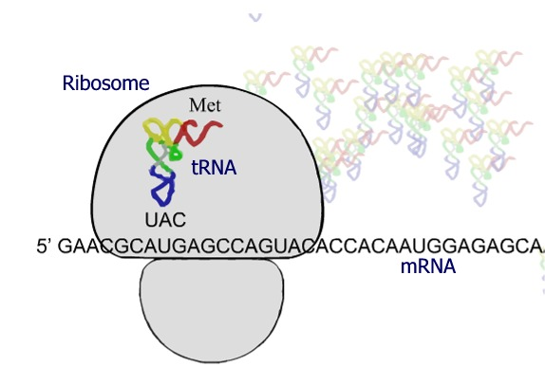
Punctuating the code - Starting
Start – AUG codes for methionine (Met). It is the initiation codon.
Translation does not start until AUG reaches the active site of a ribosome.
Every polypeptide made starts with Met, but it is often removed before the final protein is produced.

Slide 21
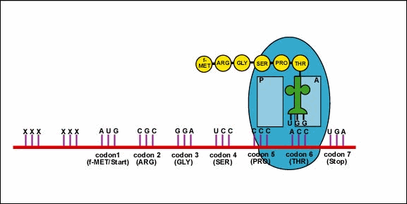
Punctuating the code - Stopping
There are three ‘termination’ or stop codons.
UAA, UGA and UAG
When one of these reaches the active site on a ribosome there is no tRNA with an anticodon for these codons so translation stops.

